Slide 1
PSS – Pharmacy Specialty Services
2022 Internal Audit IT Risk Assessment
November 09, 2021

Slide 2

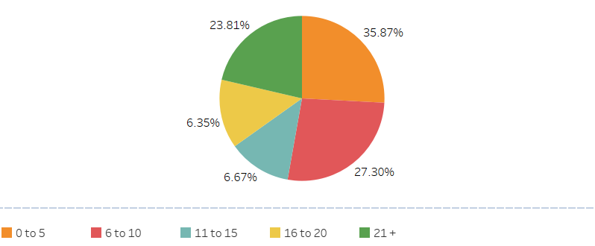
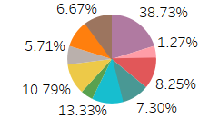
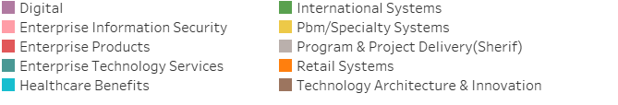
Demographics
/ 88.11%
Length of Service
IT Function

Slide 3
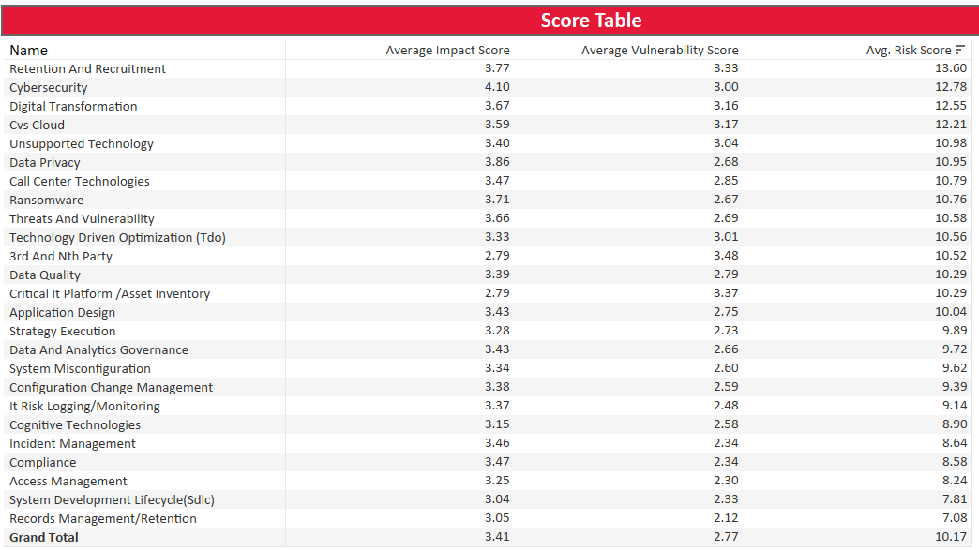
Risk Assessment Score
*Risk score= Impact Score * Vulnerability Score

Slide 4
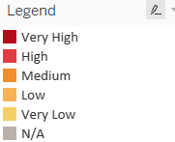
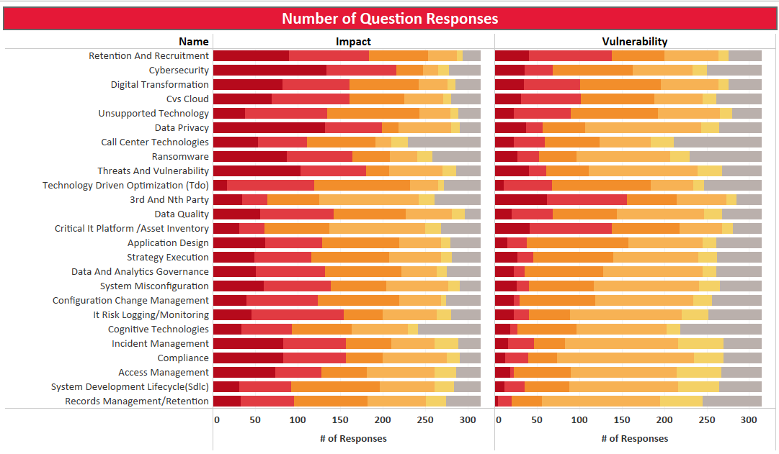
Risk Question Responses

Slide 5
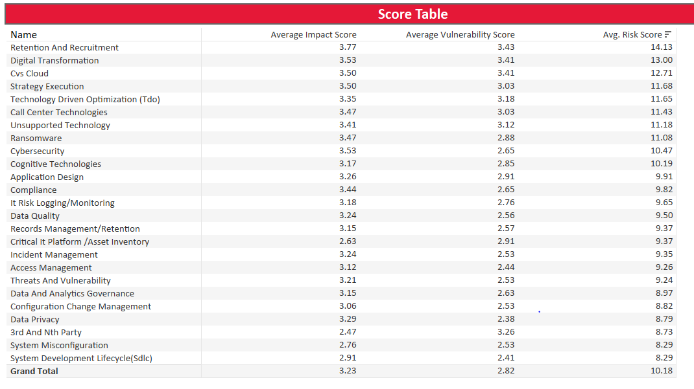
PBM/Specialty Systems Score
*Risk score= Impact Score * Vulnerability Score

Slide 6
Risk Exposures
IT Governance
Increased Technical Debt
Cloud Modernization Delays
Third-Parties
Limited Third-Party Risk Monitoring
Unsupervised Privileged Access
Ransomware
Proliferating Ransomware Attacks
Evolving Ransomware extortion strategies
Notes:
THIRD PARTIES
What processes are in place to continuously monitor key third parties' access to pharmaceutical and clinical data?
How do you monitor permissions granted to individual users at third parties to pharmacy specialty services?
How are critical third parties identified and prioritized for risk assessments and monitoring?
IT GOVERNANCE
What are the biggest sources of technical debt in the organization with the implementation of cloud modernization efforts?
What have been the most significant changes to the Pharmacy Specialty Service architecture during the past two years?
What are the primary goals of the enterprise cloud strategy for pharmacy specialty services, and how do they align with the enterprise strategy?
What are the most significant changes in IT operating model and controls being enacted to maintain or improve IT governance in cloud?
RANSOMWARE
What protocols are in place for responding to ransomware attacks?
What are the protocols in place to protect PII and PHI information housed within Pharmacy Specialty Service applications?
How is the environment monitored from cybersecurity attacks given the increasing virtual workspace model employed by Pharmacy Specialty Services?

Slide 7
Agenda
Survey Results
Planned 2022 IT Audits
Potential 2022 IT Audits
2022 Audit Plan Timeline

Slide 8
2022 Planned IT Audits
2022 Potential IT Audits
1. SureScript – 3rd Party Audit
2. Application Authentication
myPBM and Benefit Automation
AFP: Align for Profitability
Single Source Elig and C2C Elimination
Zinc
Specialty Formulary and Trends Master
Notes:
2022 POTENTIAL IT AUDITS
Question: Are we using the “All FY22 Planning excel doc file” or the “Golden File excel doc file?”
myPBM and Benefits Automation: Budget allocation (Total Expense: Capital + Expense): $20,783,700
- Capture client requirements using digital tools and automate the load into RxClaim. Achieve direct mapping from Aetna upstream systems for Pharmacy Benefits to the Pharmacy PBM ODM engine.
AFP: Align for Profitability: $12,586,600
- Underwriting Transformation Master. This Program will deliver more profitable growth by enhancing key financial & underwriting processes to increase accuracy, reporting granularity, and accelerate profitability analysis.
Single Source Elig and C2C Elimination: $12,549,530
- Multi year project to eliminate C2C - mail and digital and all other gaps to use global ID. Real time eligibility – API for member and group elig updates. Enhance Elig workflow to encompass COLA and library setups.
Zinc: $11,490,000
- IBEX NDA
(External) – Pharmacy Benefits Management Business (GPO – Group Purchasing organization) To be launched.
Specialty Formulary and Trends Master: $7,051,030
- Project will provide new development for the expansion of the PrudentRx Copay Optimization program, new capabilities to support specialty utilization management efforts.
2022 PLANNED IT AUDITS
1. Surescript – 3rd Party Audit
(Question) Are we looking at this area as a 3rd party review? Any concerns around this vendor? How is it managed? Any risks in this area?
(External) – Unites virtually all electronic health records (EHR) vendors, pharmacy benefit managers (PBMs), pharmacies and clinicians, plus an increasing number of health plans, long term and post-acute care organizations, specialty hubs and
specialty pharmacy organizations.
Core areas:
1. Enhance Prescribing
2. Inform Care Decisions
3. Advance Healthcare
4. Increasing Patient Safety
5. Lowering costs
6. Ensuring Quality Care
Application Authentication: Is Application Authentication same as Clinical Service Application?
- SOX testing identified non-SOX issues related to Application Authentication on the QL Mainframe (users can authenticate to mainframe outside network), and AMRSII Application Code (hardcoded ID/Password in Configuration file)
- Provide functional and functional regression testing both manual and automation leveraging tools. Perform routine release staging shakeout for applicable applications.
- Leadership: Dikran Tokmakjian ( Senior Manager, IT Systems)
----------------------------------
OTHER POSSIBLE IT AUDIT AREAS:
Project Compass – Pharmacy Help Desk Functionality
- Compass (formerly known as Polaris) is a multi-year project to transform the customer service experience our call center agents provide to our members. This transformation will be characterized by the introduction of new technology that
will empower agents with necessary tools to easily and confidently provide the personal assistance members need.
Question: What is the big initiative scheduled for 2022?
SimpleDose - (Question: Are we working at enhancing this system)
Consolidate Vendor Partners
- Move outsource contact center vendors to our telephony network (ACD), our workforce management and call recording and analytics solutions to create single telephony environment. Infrastructure investment is
needed to support 5,000 peak vendor Representatives on CVS Caremark telephony and workforce management systems.
SPARCS Specialty Pharmacy Accounts Receivable System Modernization 21122.
- Specialty Pharmacy Accounts Receivable Collection System (SPARCS) is a web based, end to end system for the Specialty Pharmacy (SP) business It is comprised of multiple databases for SP with newer front-end systems such as SPRx being
implemented. Efforts by the development team to modernization platform by moving resource from a mainframe environment to the cloud by creating block chains in order to significantly increase the security surrounding resources hosted.
Clinical Authorization Systems CAS (Active in Auditboard 21611) – (Question: What systems were enhanced? Operational functions?)

Slide 9
2022 Audit Plan Timeline
October
Information Technology Risk Survey
November
Risk Assessment Meetings – Key Leaders
Senior Audit Director Reviews IT Audit Plan
December
Draft Plan to Chief Audit Executive
Internal Audit Reviews All Portfolio Plans
January
Audit Plan Socialization - Exec Management
Audit Plan Finalization
February
Complete Socialization with Executive Leaders
March
Audit Committee Approves 2022 Audit Plan
2022 Internal Audit Plan Year Begins

